Slide 1

Insights Dashboard

Slide 2
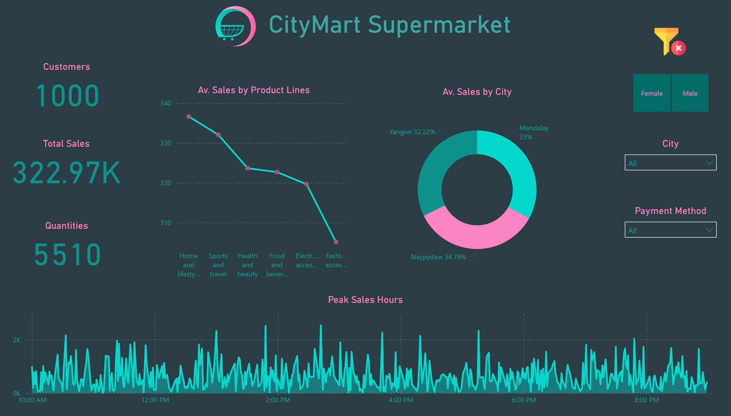
Sales Performance Overview
Notes:
Customers
No alt text provided
Total Sales
No alt text provided
City
No alt text provided
Payment Method
No alt text provided
Quantities
No alt text provided
slicer
No alt text provided
image
No alt text provided
Av. Sales by City
No alt text provided
Av. Sales by Product Lines
No alt text provided
CityMart Supermarket
No alt text provided
Peak Sales Hours
Distribution of Sales by Time of Day
image
No alt text provided

Slide 3
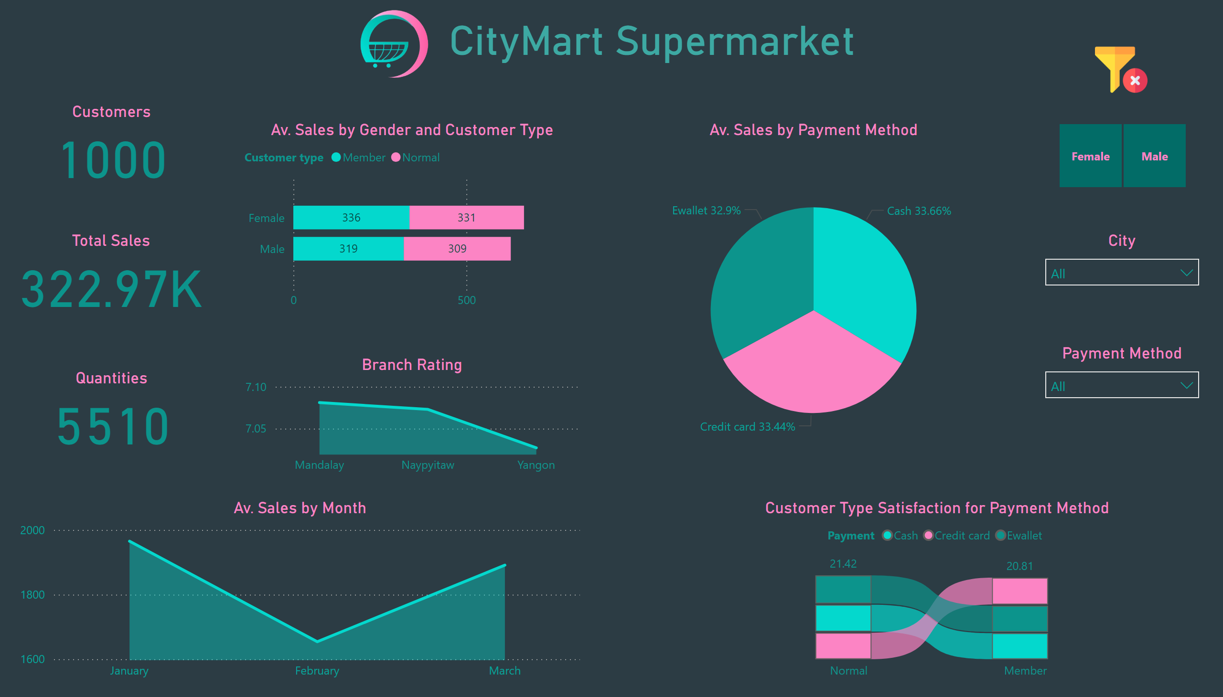
Customer Insights
Notes:
Branch Rating
No alt text provided
Av. Sales by Payment Method
No alt text provided
Av. Sales by Gender and Customer Type
No alt text provided
CityMart Supermarket
No alt text provided
image
No alt text provided
Customers
No alt text provided
Total Sales
No alt text provided
Quantities
No alt text provided
slicer
No alt text provided
City
No alt text provided
Payment Method
No alt text provided
Av. Sales by Year for Payment Method
No alt text provided
image
No alt text provided

